Slide 1



ecx.io Frontend Bootcamp — CSS Day 7 10.08.2021.

Slide 2



Introduction round

Slide 3
Agenda
SASS
Flow Control
Functions
Methodologies
OOCSS
SMACSS
ITCSS
BEM
Frameworks
Bootstrap
Bulma
Zurb Foundation

Slide 4
SASS: Flow Control

Slide 5
SASS: Flow Control
SASS provides a number of at-rules that make it possible to control whether styles get emitted, or just to emit them multiple times with small variation.
You will recognize those flow control at-rules from other programming languages, and that is one of the biggest advantages of SASS.
It gives us the opportunity to write CSS in a way similar to what we're used in other programming languages.

Slide 6
SASS: Flow Control
The following four flow control at-rules are available in sass:
@if and @else controls if a block should be shown
@each evaluates a block for each element in a list or each pair in a map
@for evaluates a block a certain number of times
@while evaluates a block until a certain condition is met
All above at-rules can be used inside mixins and functions as well.

Slide 7
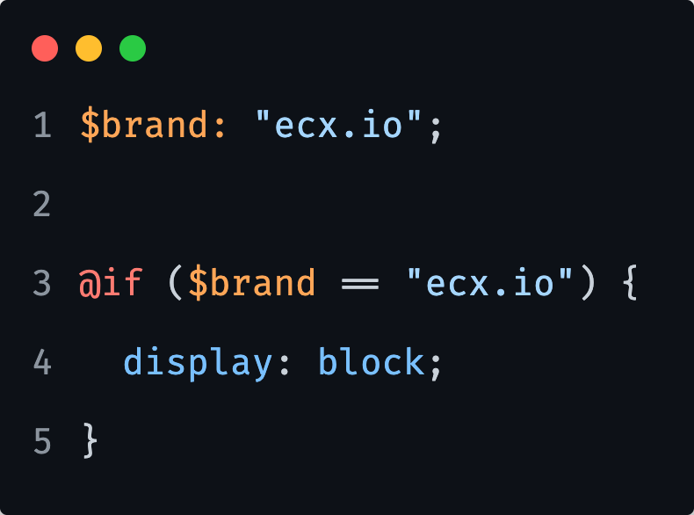
SASS: Flow Control; if
The @if rule control whether or not its block gets evaluated, or simply said if it will be emitted.
The expression usually returns either true or false.
If the expression returns true, the block is evaluated, and it is not if the expression returns false.

Slide 8
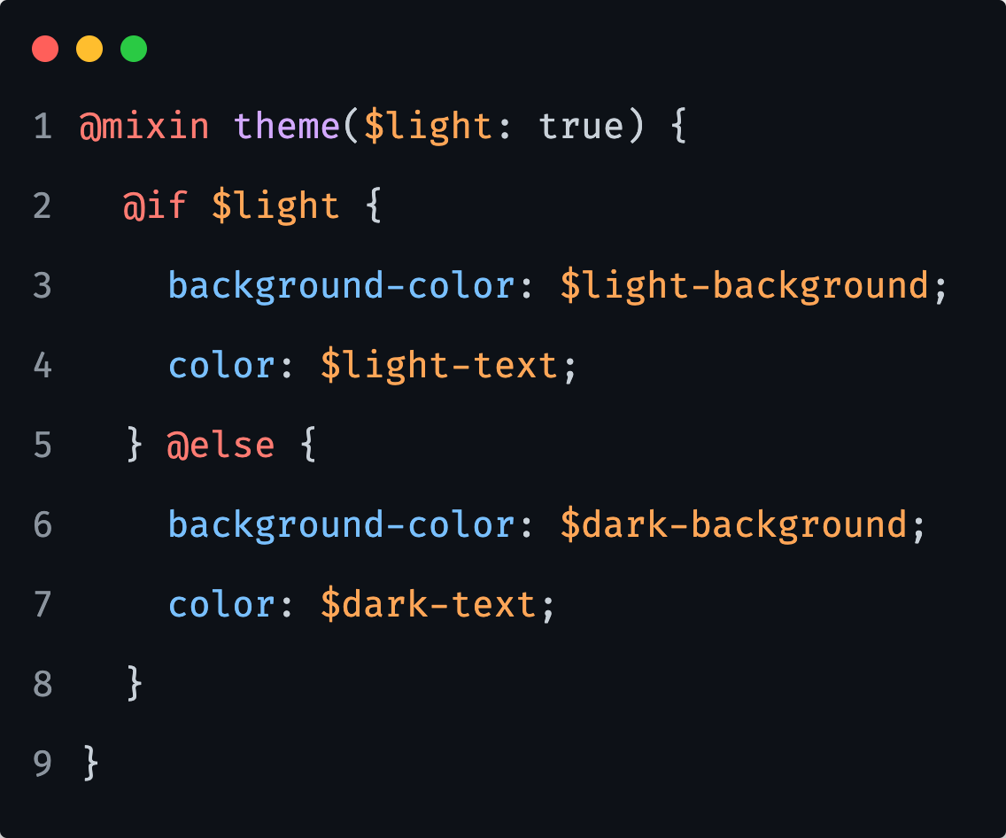
SASS: Flow Control; else
Optionally, the @if at-rule can be followed by an @else at-rule that will be evaluated if the @if expression returns false.

Slide 9
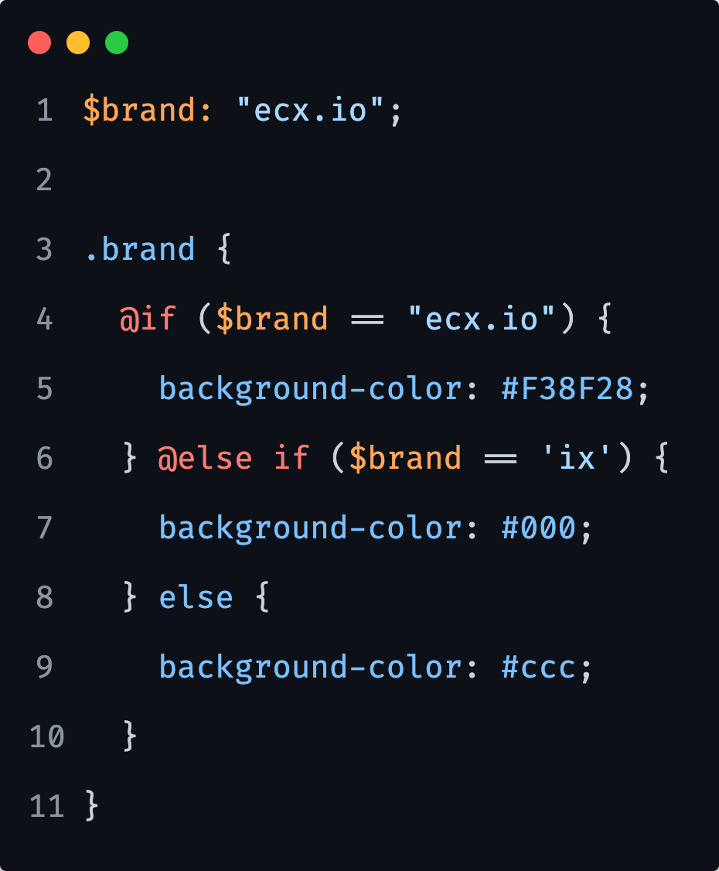
SASS: Flow Control; else if
Finally, we can chain multiple evaluations by using the @else if at rule.
Note that only the first block whose expression returns true will be evaluated.

Slide 10

1) Create a mixin that applies either dark or light color and background-color properties, based on user input. The light variation should be default, meaning we should not need to specify it either.
2) Create a mixin that will set the layout of a container either to a 4-column grid or simply center all content inside of it. It will require an argument that allows the developer to specify the desired layout.
Notes:
15 minutes

Slide 11
SASS: Flow Control; each
The @each at-rule makes it easy to emit styles or evaluate code for each element of a list or each pair in a map.
Its best use case is for repetitive styles that only have a few variations between them.

Slide 12
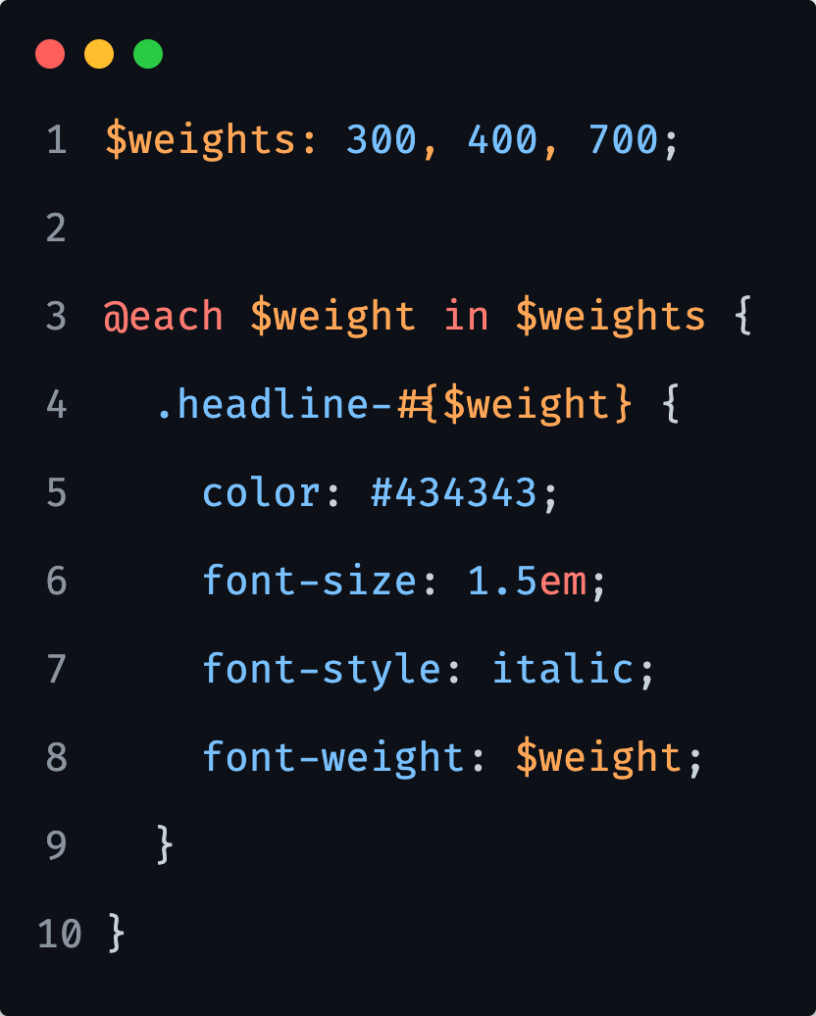
SASS: Flow Control; each
The @each at-rule makes it easy to emit styles or evaluate code for each element of a list or each pair in a map.
Its best use case is for repetitive styles that only have a few variations between them.

Slide 13
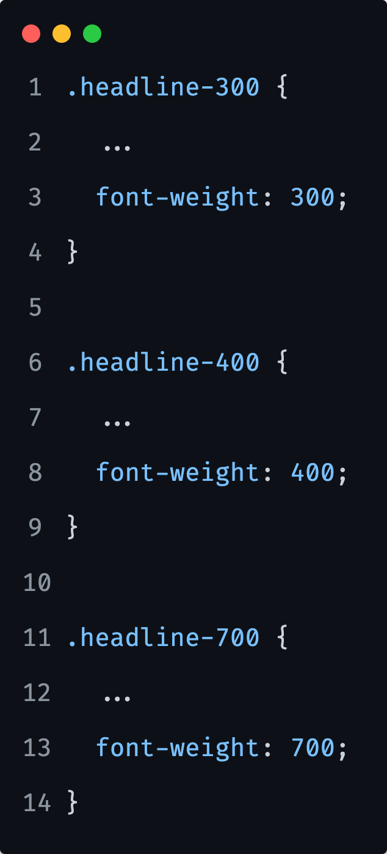
SASS: Flow Control; each

Slide 14
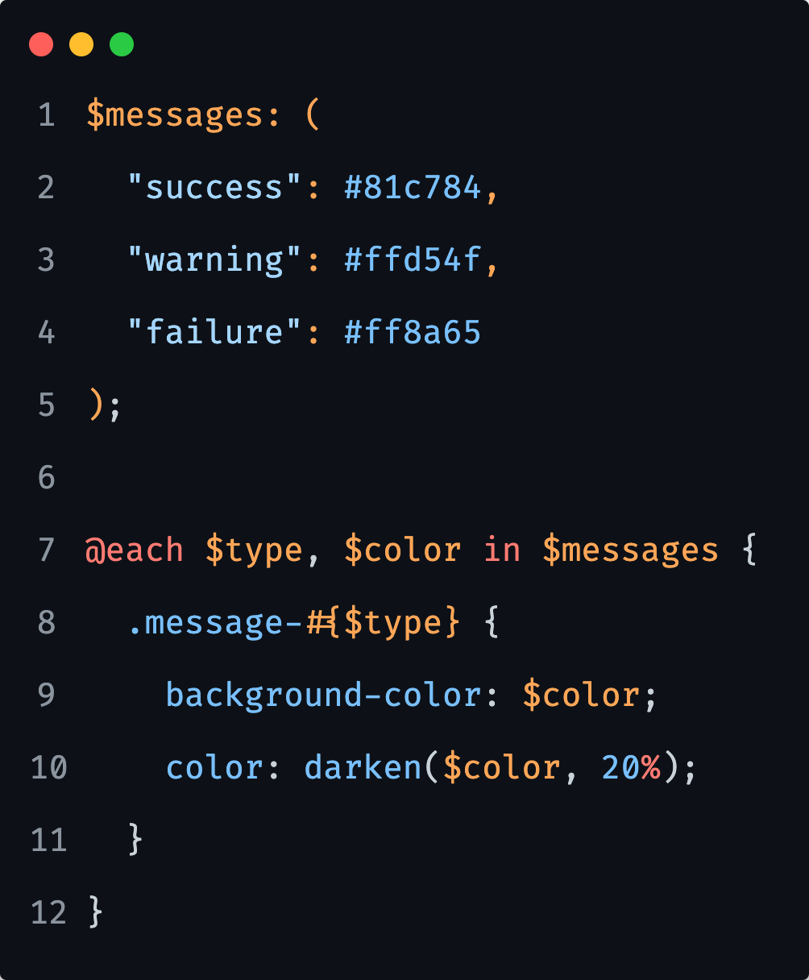
SASS: Flow Control; each
When we are working with maps, the syntax is slightly different because we need to create two local variables for the loop.

Slide 15
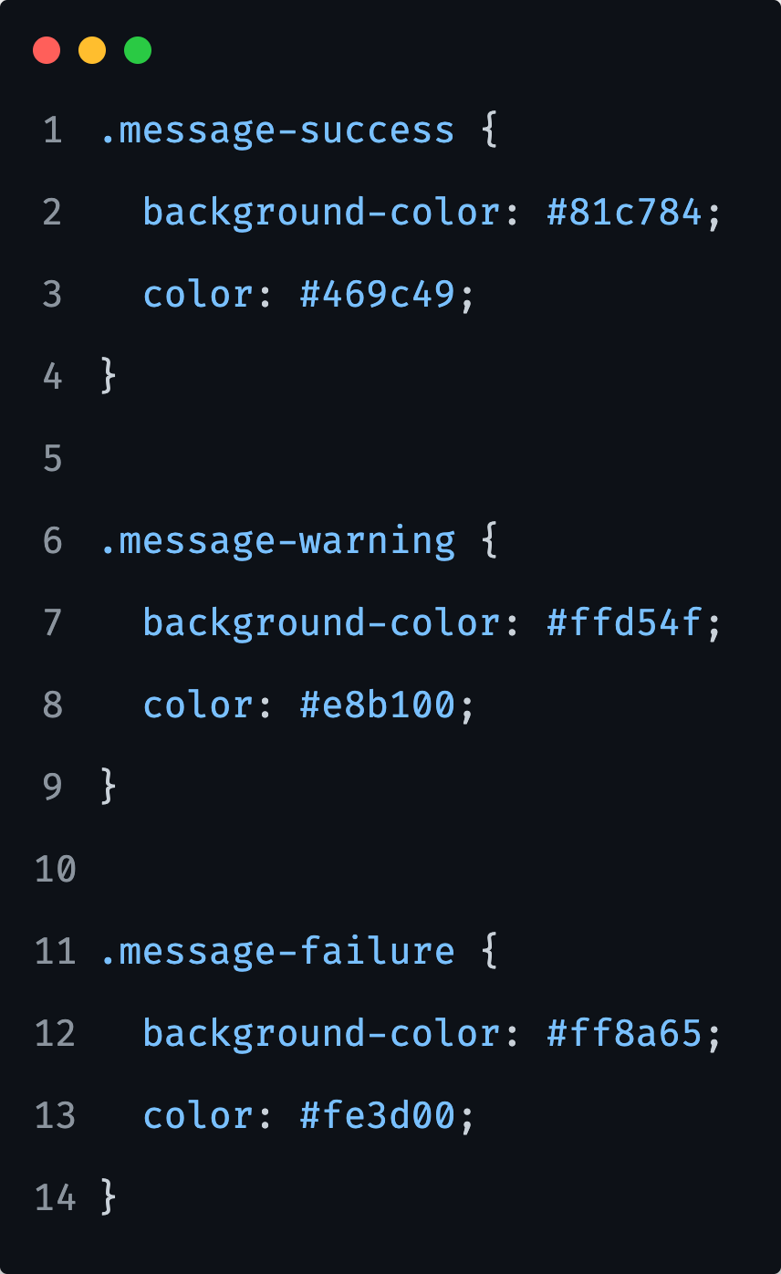
SASS: Flow Control; each

Slide 16
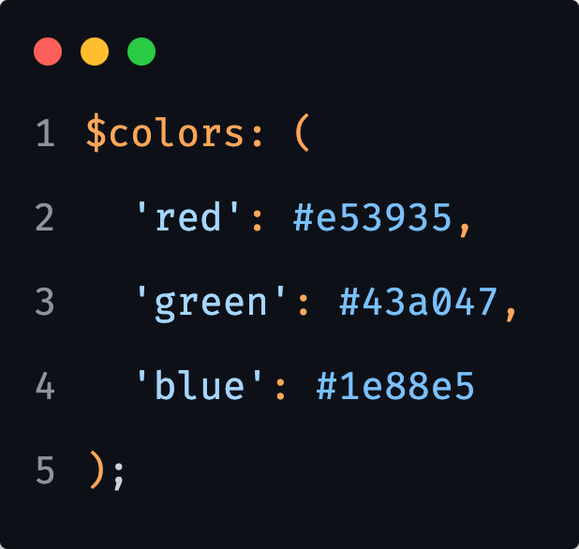
1) Using each, create classes with specified value from following list:
$weights: light, normal, bold;
2) Using each, create a class for each key/value pair that contains the key (e.g. `.background-red`) and set its background color to the value. Use following map:
Notes:
15 minutes

Slide 17
SASS: Flow Control; for
The @for at-rule counts up or down from one number to another and evaluates a block for each number in between.
Each number along the way is assigned to the given variable name.
We have two options for constructing this rule, using: to - the final number is excluded
through - the final number is included

Slide 18
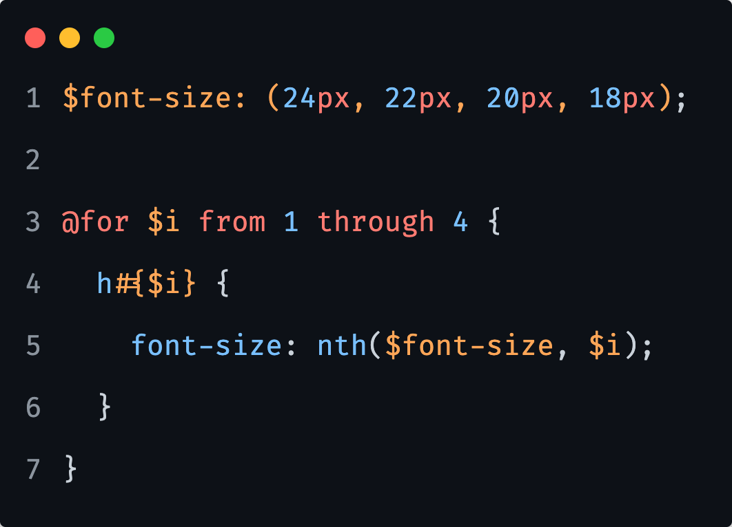
SASS: Flow Control; for
through
In the example, we want to create 4 heading styles with the font sizes from the list, so we iterate from 1 through 4 with $i as our counter variable.
Notes:
In the code block we create a h element with the counter as the heading number. We use the counter again to get the font size out of the list into the property.
With each iteration, the counter will increase, and both add the number to the h, as well as assigning the correct element value to the property.
The nth function allows a value to be plucked from a certain position in a list – like choosing the position from an array in JavaScript or programming languages.
In this instance, rather than passing the nth position we want as an integer, we are using our counter variable as a kind of ‘dynamic’ grabber to pluck the corresponding colour value from the different lists.

Slide 19
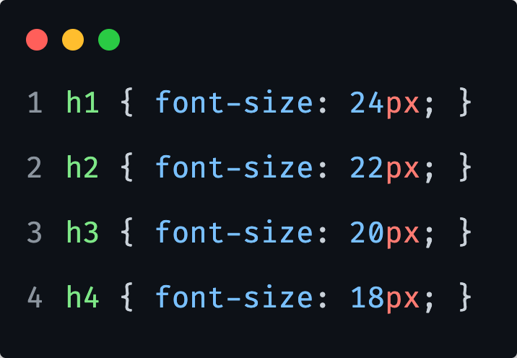
SASS: Flow Control; for
through
In the example, we want to create 4 heading styles with the font sizes from the list, so we iterate from 1 through 4 with $i as our counter variable.
Notes:
In the code block we create a h element with the counter as the heading number. We use the counter again to get the font size out of the list into the property.
With each iteration, the counter will increase, and both add the number to the h, as well as assigning the correct element value to the property.

Slide 20
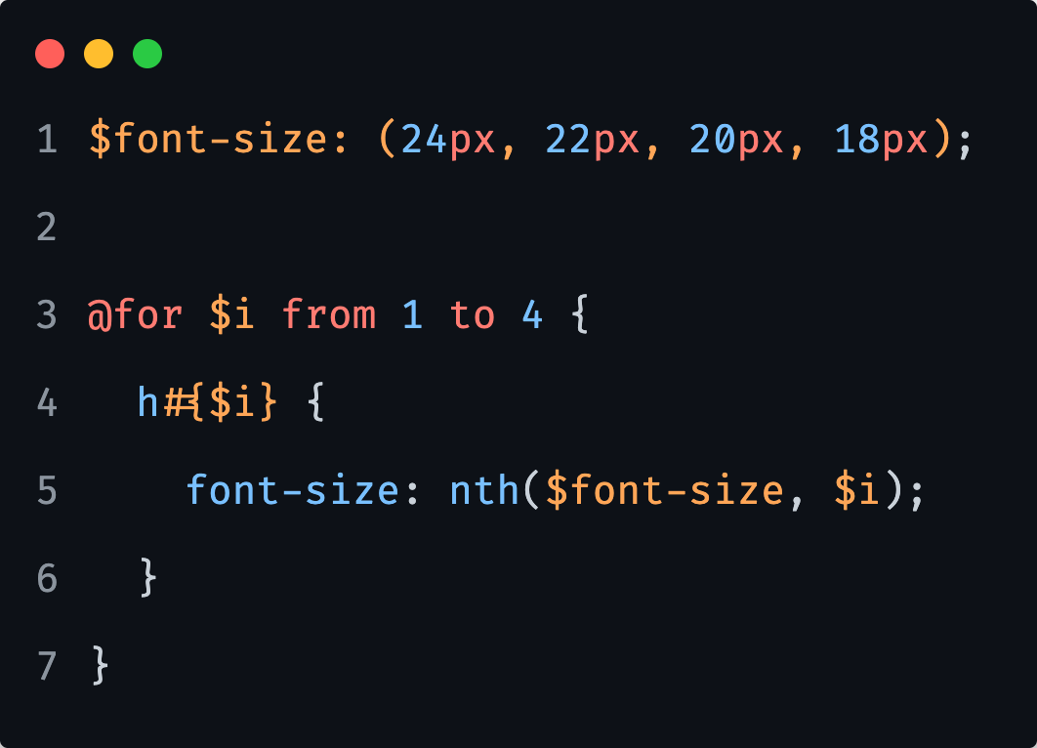
SASS: Flow Control; for
to
We can also use the to keyword in the loop if we want to exclude the last iteration.

Slide 21
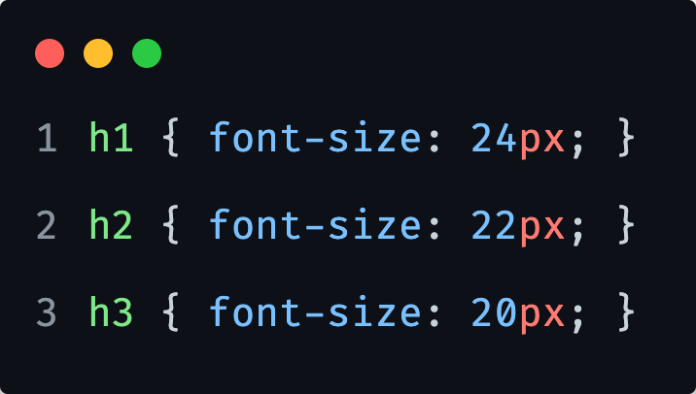
SASS: Flow Control; for
to
We can also use the to keyword in the loop if we want to exclude the last iteration.
Notes:
This time the loop will only run 3 times because it will exclude the last iteration.

Slide 22
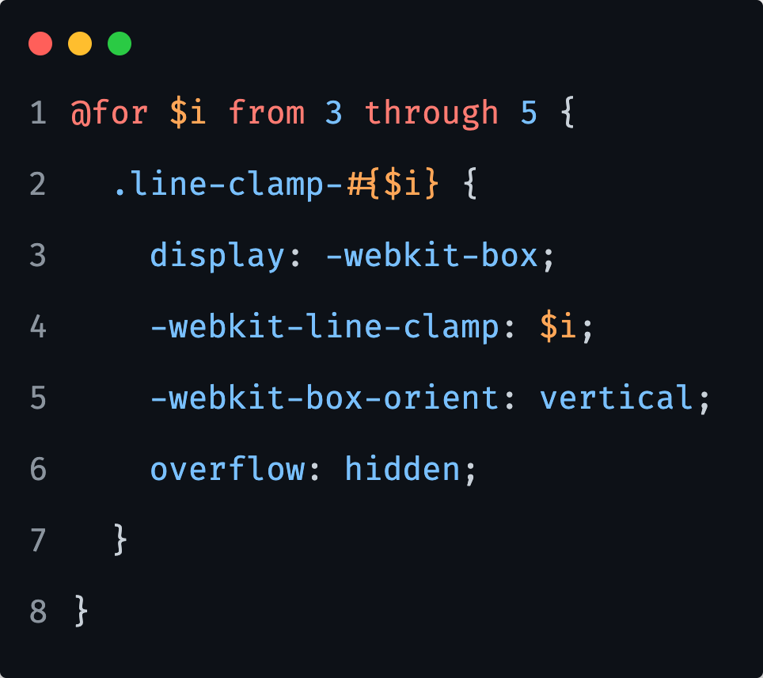
SASS: Flow Control; for
through
Another through example…

Slide 23
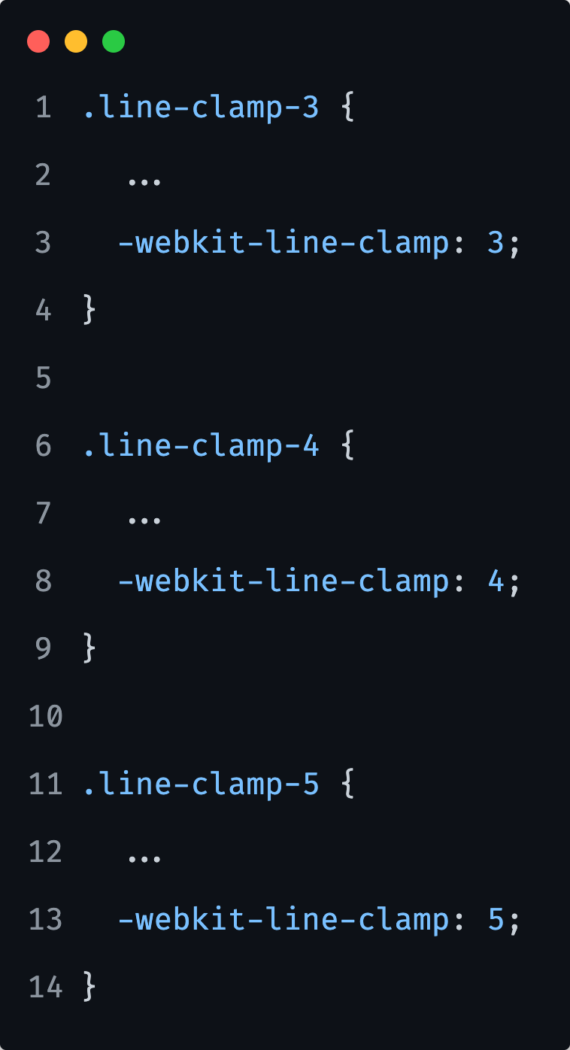
SASS: Flow Control; for
through
Another through example…

Slide 24
1) Create a for loop that will dynamically create classes for headings level 1 to 6, where the smallest will have a font size of 1rem, and each following heading will be 1rem bigger than the previous one.
Notes:
10 minutes

Slide 25
SASS: Flow Control; while
The @while at-rule evaluates its block if its expression returns true.
After that, if its expression still returns true, it evaluates its block again.
This continues until the expression finally returns false.

Slide 26
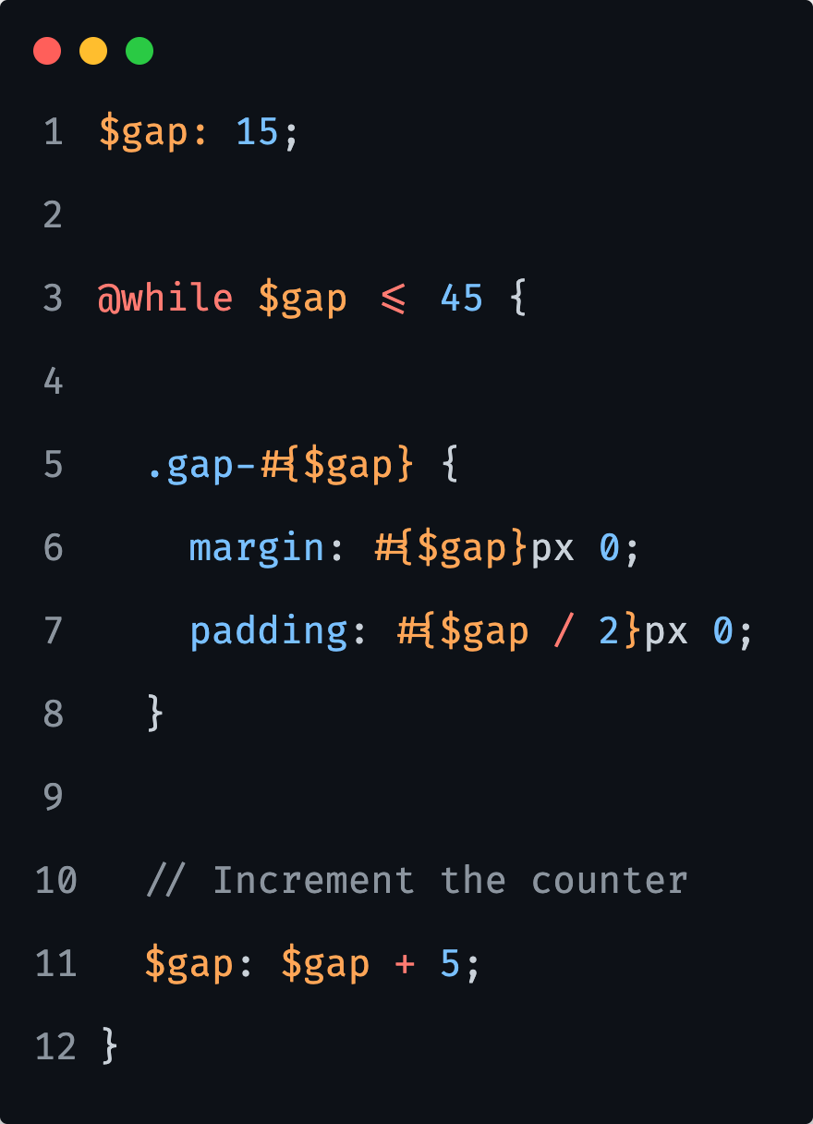
SASS: Flow Control; while
Say we want to generate number of gap utility classes…

Slide 27
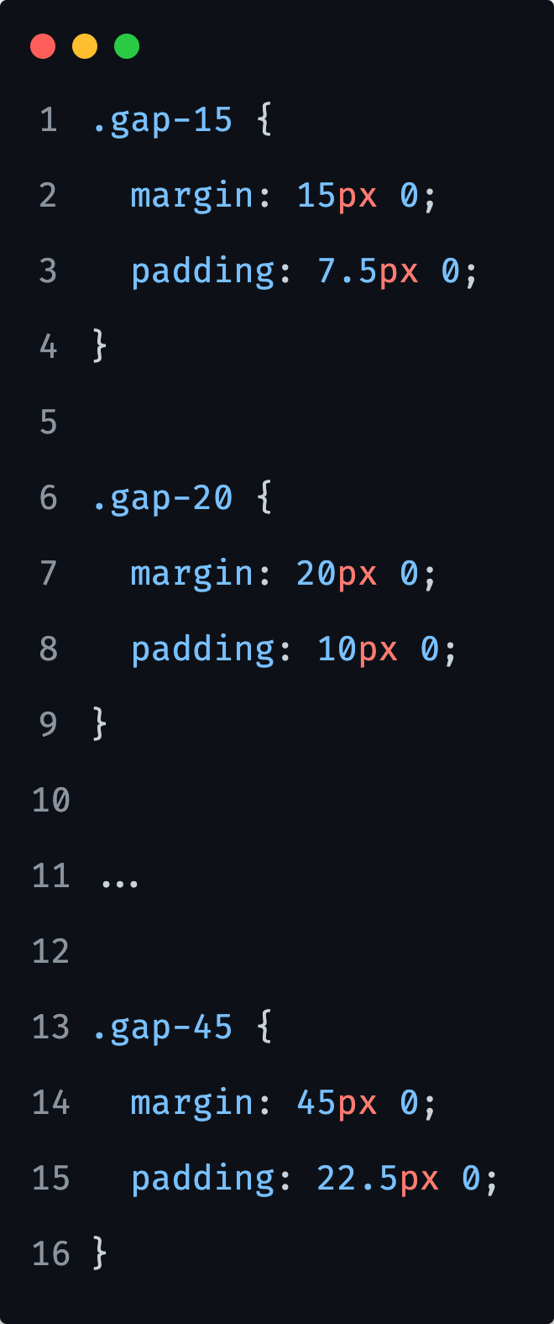
SASS: Flow Control; while

Slide 28
SASS: Flow Control; while
Although @while is necessary for a few particularly complex stylesheets, we are usually better of using either @each or @for if either of them will work.
They're clearer for the reader, and often faster to compile as well.

Slide 29
1) We have the starting $count variable:
$count: 1;
Dynamically create 5 classes that will position the element from the top in steps of 10%.
For example, the first class should position it 10% from the top, the second 20%, ...
Notes:
15 minutes

Slide 30
SASS: Flow Control; @for vs @while vs @each
All three loops will, with some modification, be able to do whatever iteration control you need.
The @for loop is typically used when we need our loop to run a specific number of times.
The @while loop is typically used when the number of times the loop will run is unknown and based on a condition.
The @each loop is typically used to iterate over items in a list or map collection.
Notes:
That said, each loop is better suited to certain tasks than others.
Summary:
Iteration control allows to control the flow of our script by using loops to execute sections of code repeatedly.
The @for loop repeats code for a set number of times.
We need to specify the start and end numbers with the from and to/through keywords.
The @while loop repeats code while a condition remains true.
The @each loop repeats code for each element in a list or map collection.

Slide 31
SASS: Functions

Slide 32
SASS: Functions
Inside SASS, functions allow us to define complex operations on Sass-Script values that we can re-use throughout our stylesheet.
This makes it easy to abstract out common formulas and behaviors in a readable way.

Slide 33
SASS: Functions
SASS functions are defined using the function at-rule which is written in the following way:
@function <name>(<arguments>) { ... }
Note that a function name can be any SASS identifier and it can only contain universal statements, as well as the @return at-rule which indicates the value to use as the result of the function call.

Slide 34
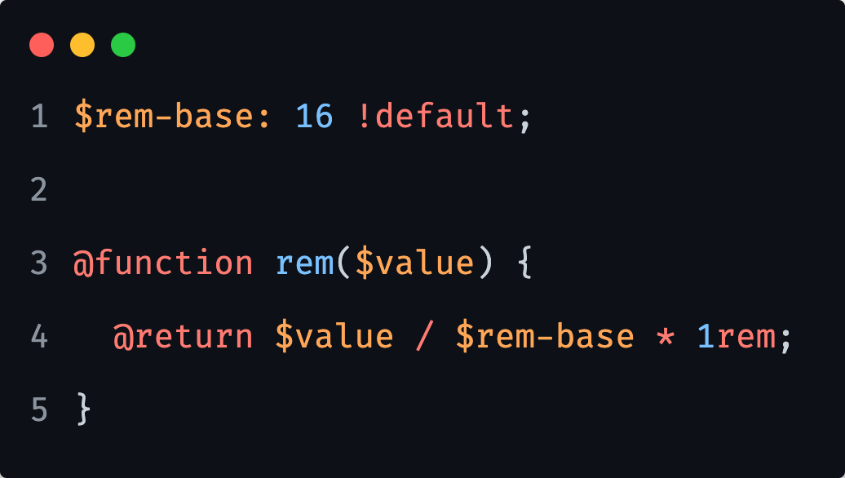
SASS: Functions
For example, we can define a simple function that will convert pixel values to rems.
Notes:
So we define a base, which is in our case 16 (note that we are not specifying here a px unit, or any other unit in fact).
Then we divide the specified pixel value with the rem base (our 16) and we multiply that with 1rem, so we get the `rem` unit.

Slide 35
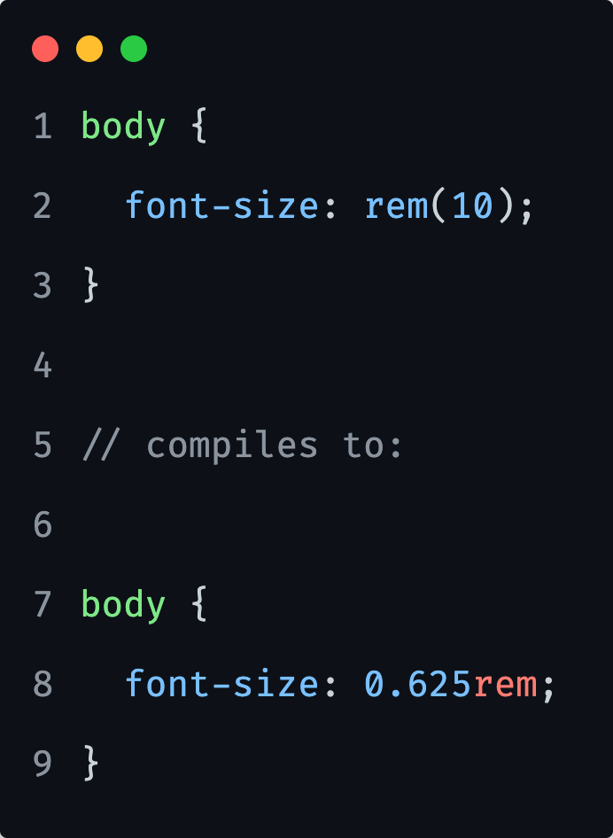
SASS: Functions
For example, we can define a simple function that will convert pixel values to rems.
Notes:
So we define a base, which is in our case 16 (note that we are not specifying here a px unit, or any other unit in fact).
Then we divide the specified pixel value with the rem base (our 16) and we multiply that with 1rem, so we get the `rem` unit.

Slide 36
SASS: Functions; arguments
Just like in any programming language, arguments allow functions' behavior to be customized each time they’re called.
The arguments are specified in the @function rule after the function’s name, as a list of variable names surrounded by parentheses.
Notes:
The behavior is the same as in the case with mixins - the function must be called with the same number of arguments as there are in the function definition.
The passed arguments will be available in the function's body as corresponding variables.

Slide 37
SASS: Functions; arguments
Three things to have in mind when working with functions and their arguments:
Optional arguments
Keyword arguments
Arbitrary arguments

Slide 38
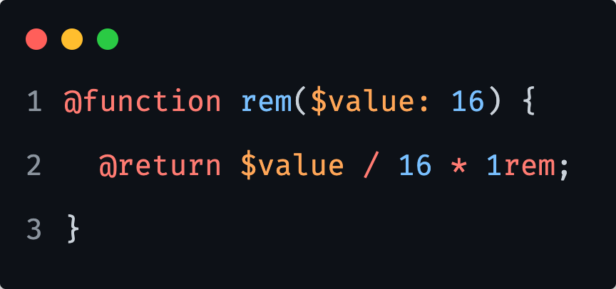
SASS: Functions; arguments
Optional Arguments
We can make an argument optional by defining a default value which will be used if that arguments isn't passed.
This behaves in the same way as the case with mixins.

Slide 39
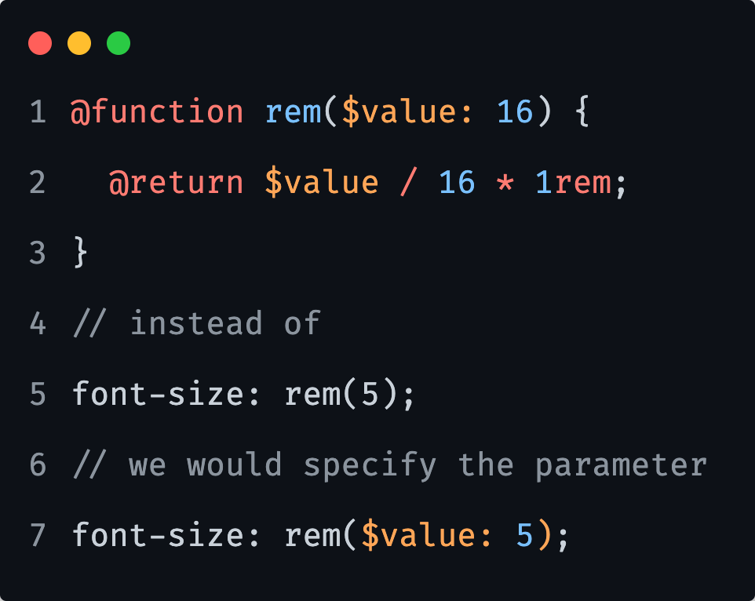
SASS: Functions; arguments
Keyword Arguments
When a function is called, arguments can be passed by name in addition to passing them by their position in the argument list.
This can be especially useful for functions that have multiple optional arguments or with boolean arguments whose meanings aren't obvious without a name describing them.
Again, this is very similar to keyword arguments in mixins.

Slide 40
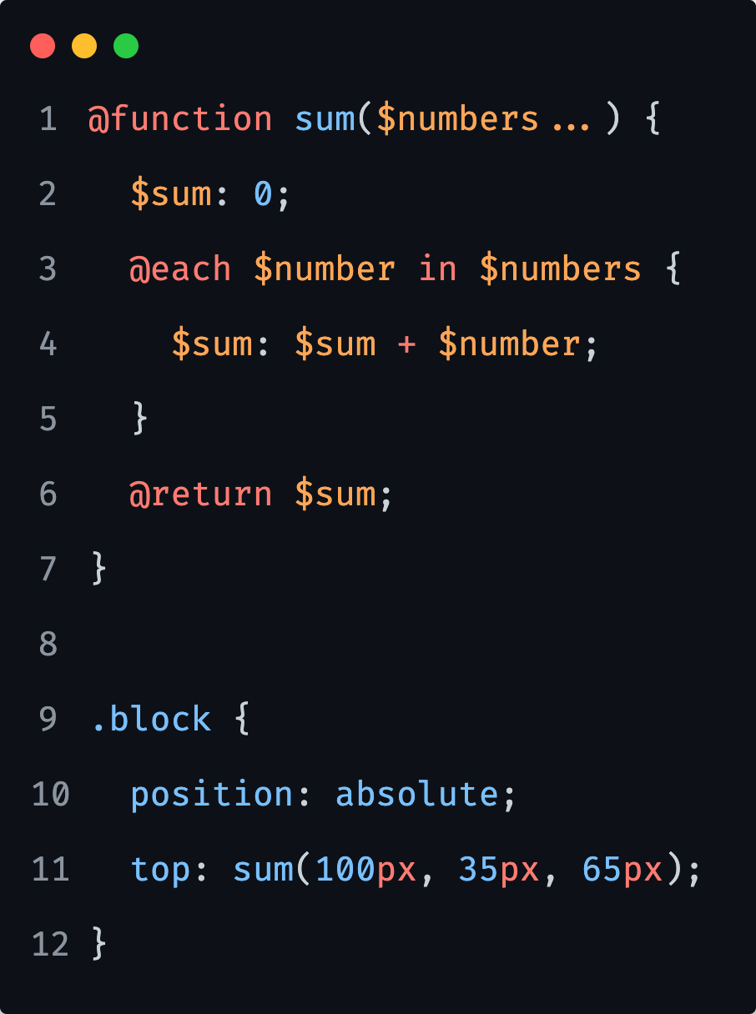
SASS: Functions; arguments
Taking Arbitrary Arguments
Sometimes we will encounter cases where it is useful for a function to be able to take any number of arguments.
This can be achieved if the last argument in a @function declaration ends in `...`.
Then all extra arguments to that function are passed to that argument as a list.

Slide 41
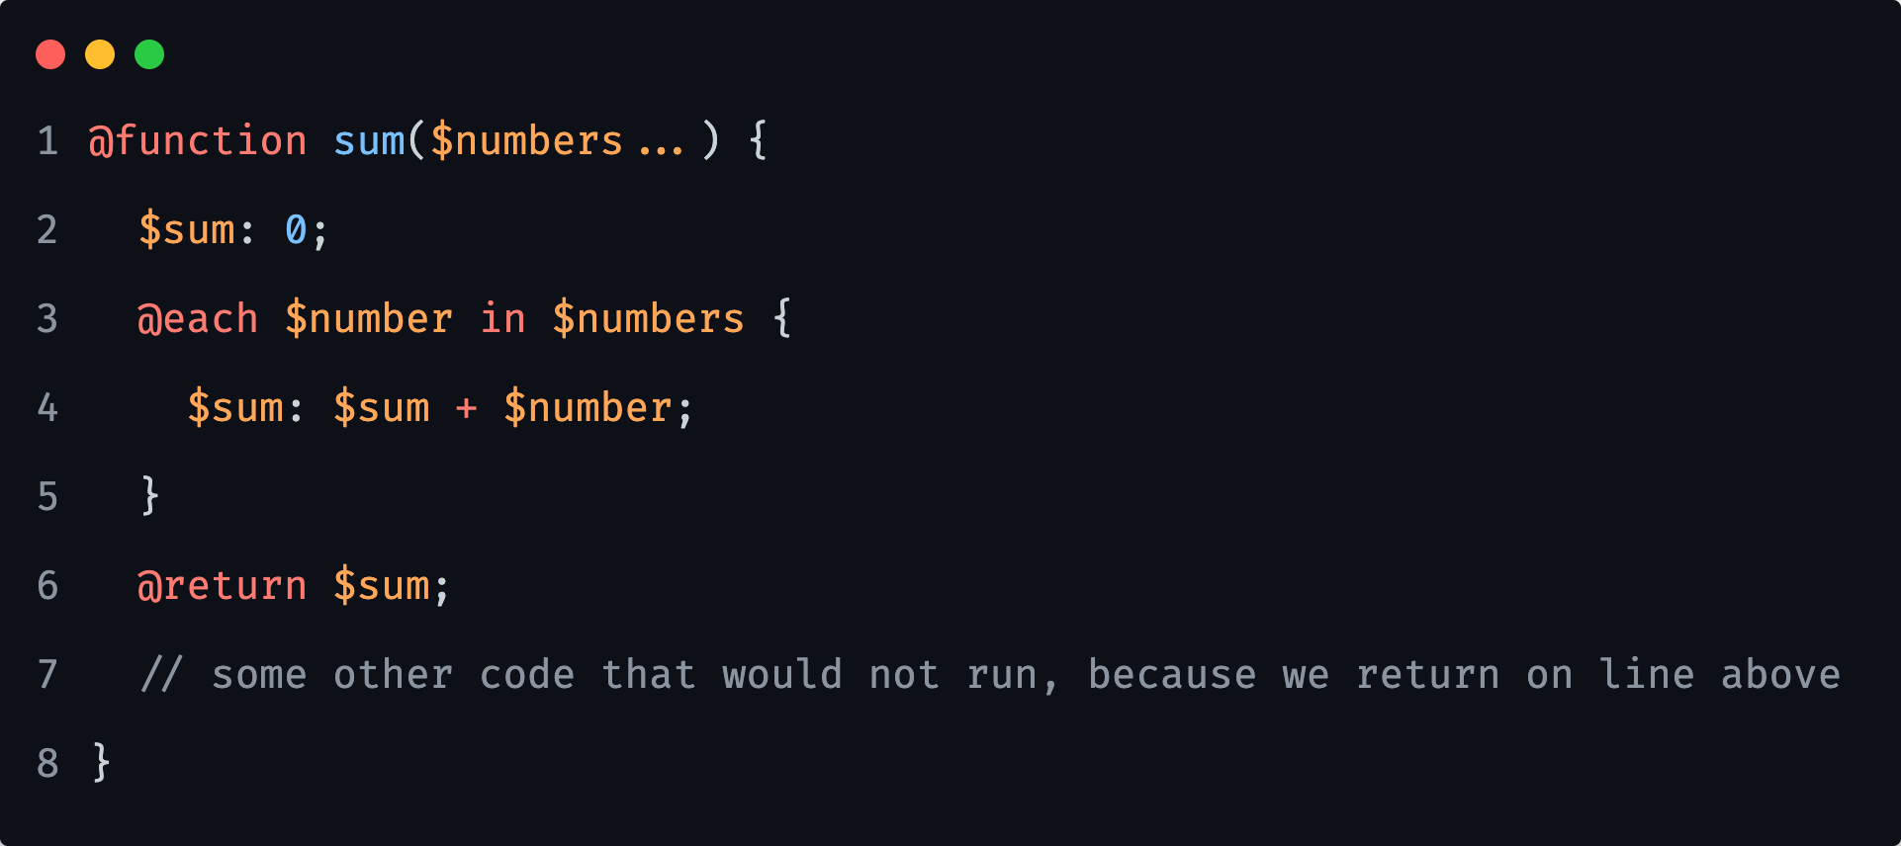
SASS: Functions; @return
The @return at-rule indicates the value to use as the result of calling a function.
This at-rule is only allowed within a @function body, and each @function must end with a @return.
When a @return is encountered, it immediately ends the function and returns its result.

Slide 42
1) Write a function that will take two arguments (should be numbers!) and returns their sum.
2) Write a function that can take any number of arguments (should be numbers!).
It needs to return the largest of the numbers that were passed in.
Notes:
15 minutes

Slide 43
SASS: Functions; Built in
Built-in functions are globally available helper functions to aid in development.
We have:
Color Functions
Math Functions
String Functions

Slide 44
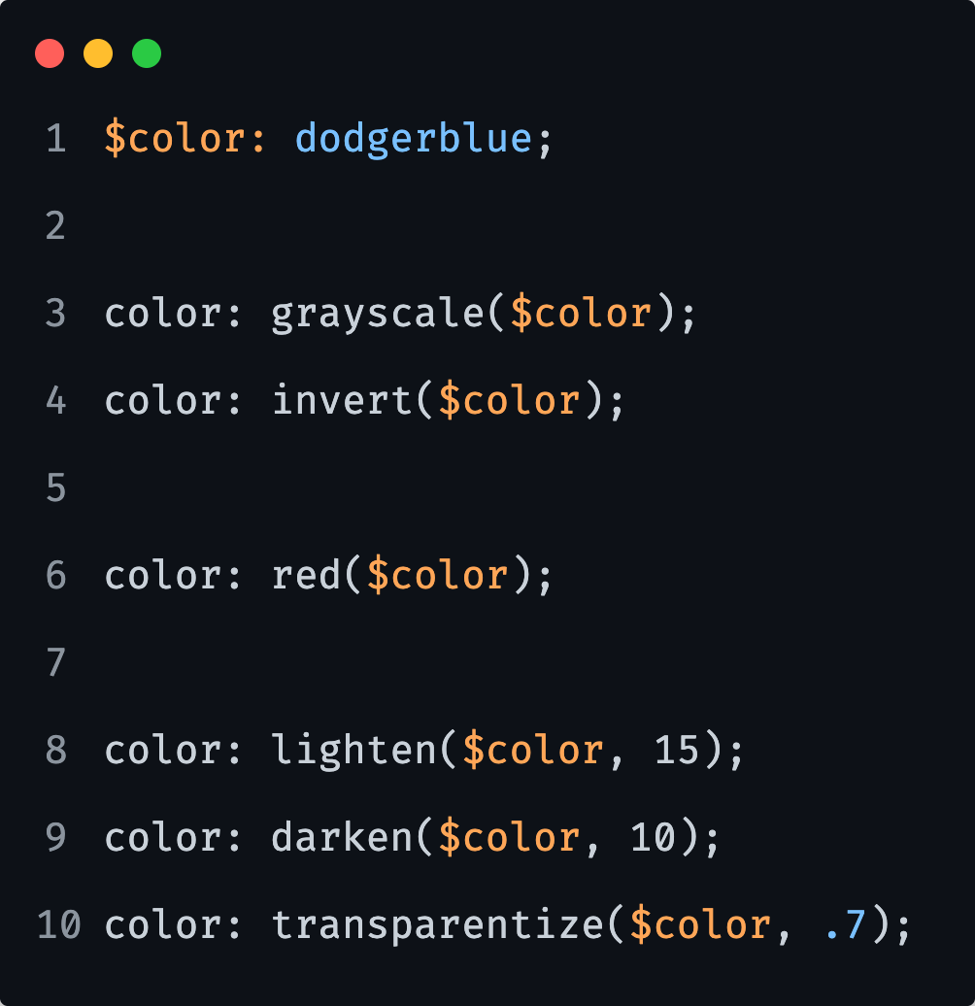
SASS: Functions; Built in
SASS Colour Functions
grayscale($color) Returns a gray with the same intensity as $color
invert($color) Returns the inverse of the individual red, green and blue components of $color.
red($color) Returns the red component of $color.
lighten($color, $amount) Lightens the specified color by the percentage specified in $amount.
darken($color, $amount) Darkens the specified color by the percentage specified in $amount.
transparentize($color, $amount) Reduces the opacity of $color by the percentage specified in $alpha.

Slide 45
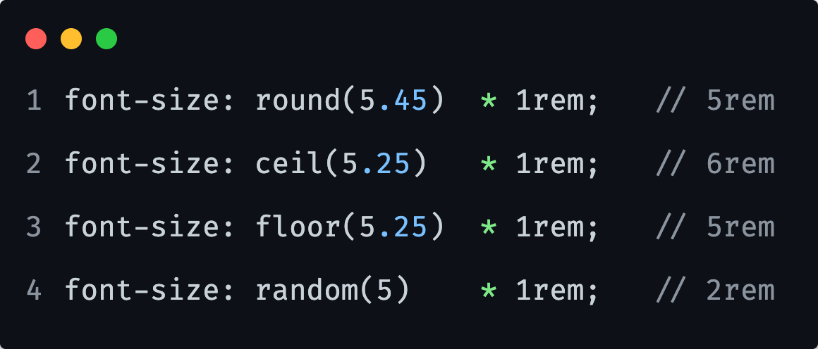
SASS: Functions; Built in
SASS Math Functions
round($number) Round a number to the nearest whole number.
ceil($number) Round a number up to the nearest whole number.
floor($number) Round a number down to the nearest whole number.
random($number) Return a random value larger than 0 and smaller than 1.

Slide 46
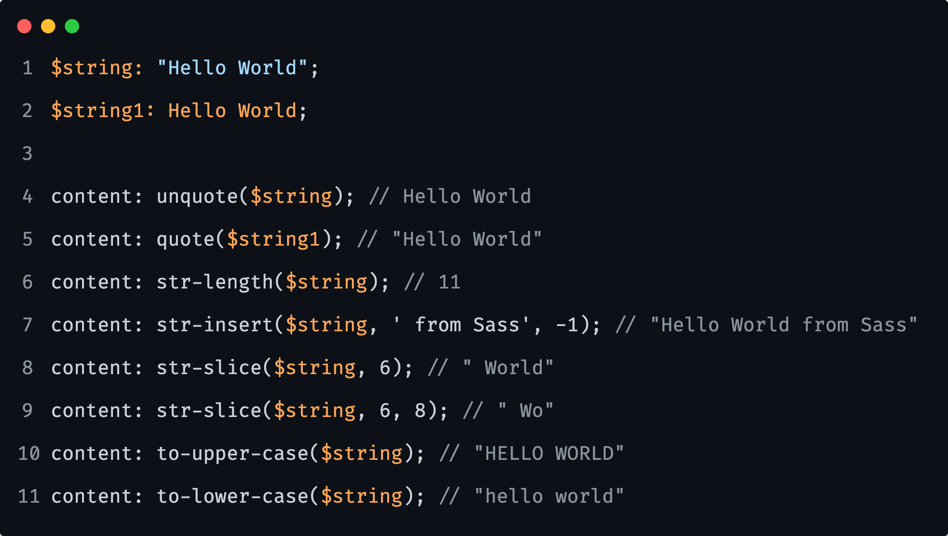
SASS: Functions; Built in
SASS String Functions
unquote($string) Removes any quotes around a string.
quote($string) Add quotes to an unquoted string.
str-length($string) Return the number of characters in a string.
str-insert($string, $insert, $index) Insert the string specified as $insert at the specified $index position inside $string.
str-slice($string, $start-at, [$end-at]) Return a substring beginning at position $start-at and, optionally, ending at position $end-at.
to-upper-case($string) Return a string containing $string converted to upper case.
to-lower-case($string) Return a string containing $string converted to lower case.

Slide 47
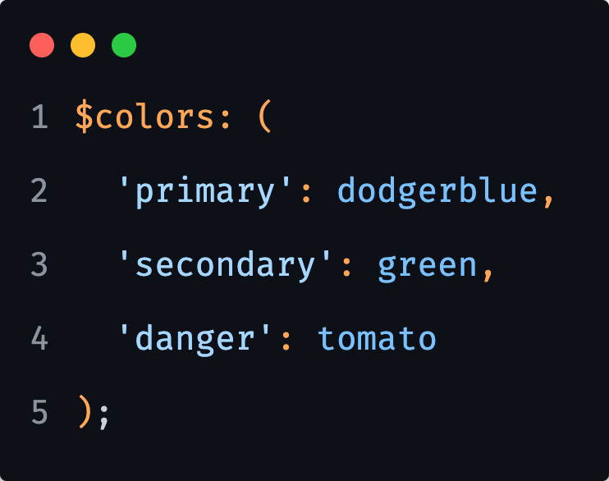
1) Create 3 different button styles with 1 color each, using SASS built—in functions to define different states of one color.
Use the following map.
Notes:
10 minutes

Slide 48
Methodologies OOCSS SMACSS ITCSS BEM

Slide 49
Frameworks Bootstrap Bulma Zurb Foundation

Slide 50
Reference links

Slide 51

Reference links
SASS
Flow Control
https://sass-lang.com/documentation/at-rules/control
Functions
https://sass-lang.com/documentation/at-rules/function
https://openclassrooms.com/en/courses/5625786-produce-maintainable-css-with-sass/5722956-create-and-use-sass-functions
Methodologies
OOCSS
https://www.keycdn.com/blog/oocss
https://www.slideshare.net/stubbornella/object-oriented-css/42-Consistency
SMACSS
http://smacss.com/
ITCSS
https://www.xfive.co/blog/itcss-scalable-maintainable-css-architecture/
BEM
http://getbem.com/
Atomic Design https://bradfrost.com/blog/post/atomic-web-design/
Combined articles
https://www.valoremreply.com/post/5_css_methodologies/
https://www.webfx.com/blog/web-design/css-methodologies/
Frameworks
Bulma CSS
https://bulma.io/
Bootstrap
https://getbootstrap.com/
Foundation
https://get.foundation/

